Slide 1

SMART WATER MANAGNMENT

Slide 2
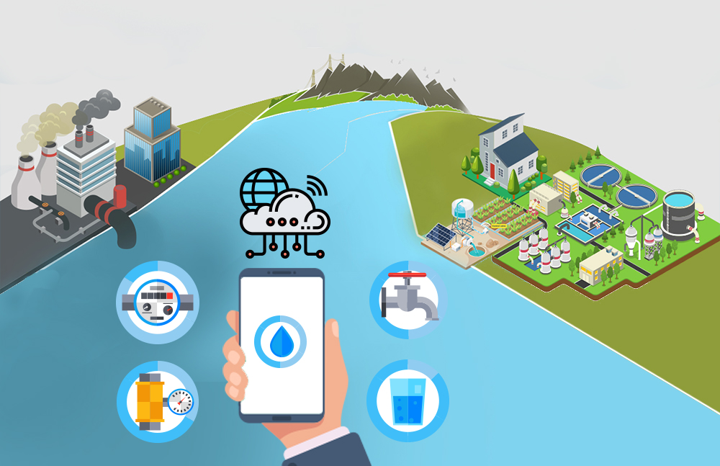
Introduction
Smart water management using IoT involves utilizing connected devices and sensors to monitor, analyze, and optimize water usage, distribution, and quality in real-time, leading to efficient and sustainable water resource management.

Slide 3
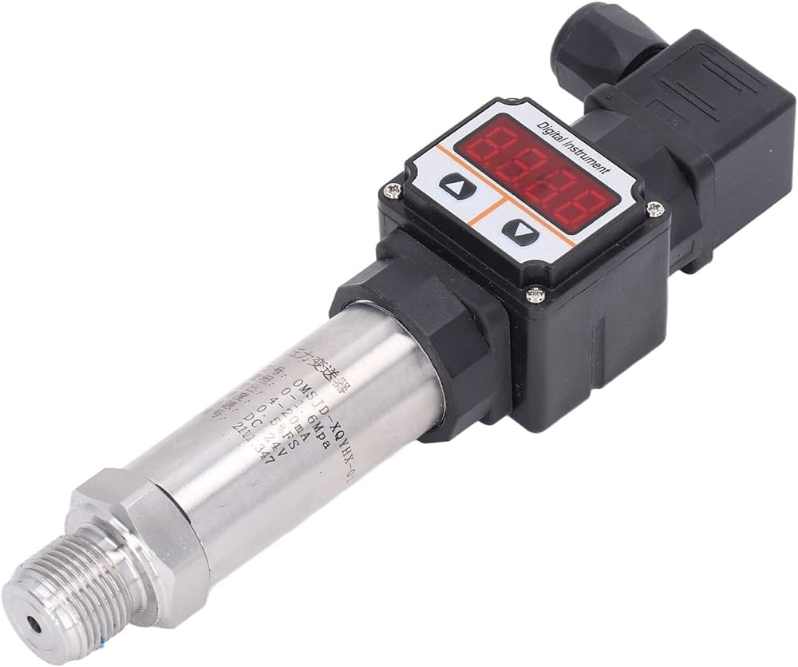
Pressure sensor
Pressure sensors in smart water management measure water pressure within the system, aiding in monitoring and maintaining optimal pressure levels for efficient distribution and preventing damage or leaks.

Slide 4
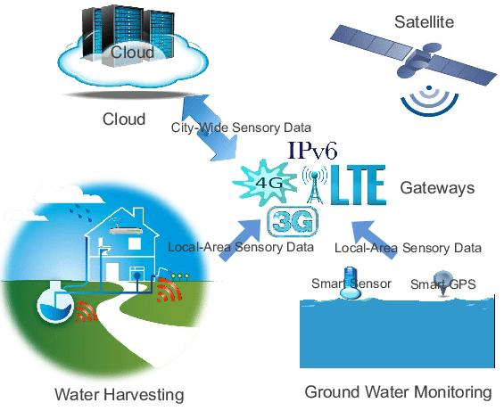
Hardware used for smart water managnment
For efficient management, hardware like computers, servers, networking devices, and storage systems are essential.

Slide 5
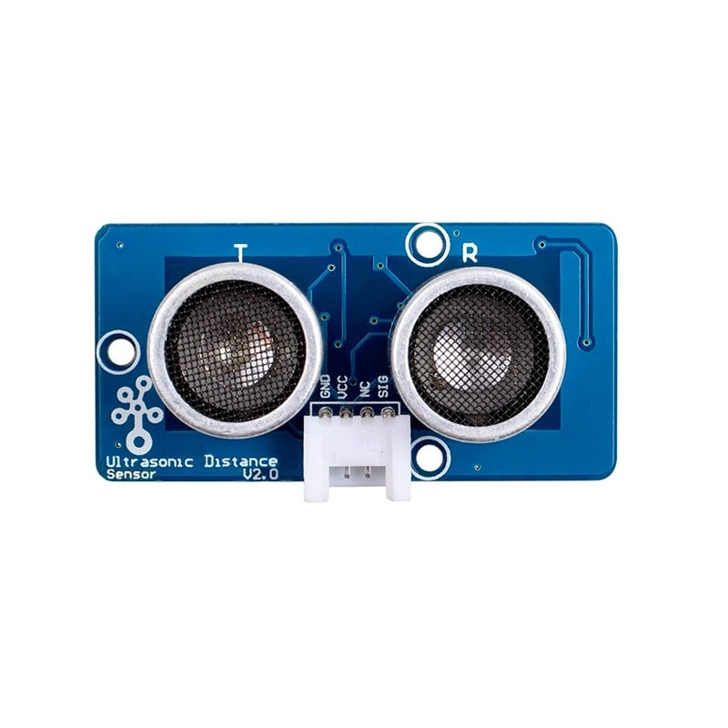
Ultra sonic sensor
Ultrasonic sensors in smart water
management measure water levels using sound waves, allowing precise monitoring of reservoirs, tanks, or water bodies. They provide real-time data to optimize water usage, detect leaks, prevent overflows, and improve overall water resource management.

Slide 6
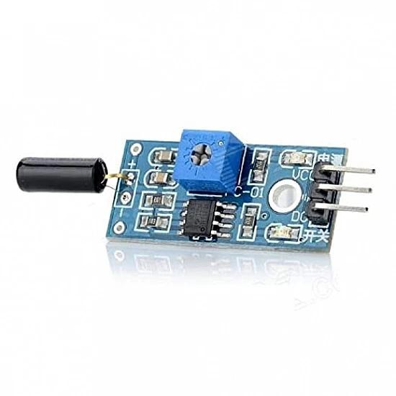
Vibrational sensor
Vibrational sensors in smart water management detect and analyze water vibrations to monitor usage patterns, leaks, or abnormalities in water infrastructure. These sensors can provide real-time data to optimize water distribution, detect leaks, and ensure efficient water consumption.

Slide 7
Ardiuino uno
Arduino Uno is a popular microcontroller used in smart water management systems, allowing for real-time monitoring and control of water usage, quality, and distribution. It can interface with sensors to measure water levels, quality, and flow rates, enabling efficient management and automation for water conservation and optimization.

Slide 8
ESP32
The ESP32, a versatile microcontroller, has been utilized in smart water management systems to monitor and control water usage, detect leaks, and optimize irrigation. Its capabilities in connectivity, low power consumption, and ability to interface with sensors make it a suitable choice for efficient water management solutions. Data collected by sensors can be transmitted to a central server for analysis, aiding in effective resource allocation and conservation.

Slide 9
Conclusion
Smart water management is essential for a sustainable future, optimizing water usage through technology and data analysis. It helps conserve resources, improve efficiency, and adapt to growing water challenges, ensuring a resilient and environmentally responsible approach to water utilization.

